Slide 1

FINANCE TRACKING VIA SMS
BCA 6 – SEATNO:- 21260153
SHREE SWAMINARAYAN COLLEGE
OF COMPUTER SCIENCE – SSCCS
AFFILIATED TO M. K. BHAVNAGAR UNIVERSITY
Prepared By:- Chavda Rohit M

Slide 2
Project Profile
Project Title | Finance Tracker Via SMS
Project Guide | Mr. Parthik Patel
Operating System | Windows 10
Server | Firebase
Front-End tool | XML in Android Studio
Back End tool | Firebase Real-time Database, Firebase Storage, Java
Project Duration | 3 Months (90 Days)
Submitted By | Mr. Chavda Rohit Manharlal
Submitted To | Shree Swaminarayan College of Computer Science, Sardarnagar, Bhavnagar

Slide 3
Table of contents
01
Introduction
02
Objective
03
04
Obstacles
Existing vs New
Overall introduction of the project.
The Main focus to make this project.
Representation
The Application UI design and Explanation.
Limitation of this project.
DFD
05
06
Where the DATA FLOWS from one module to another.
The Key difference between the Old and new system.

Slide 4
Table of contents
07
ER DIAGRAM
08
AUTHENTICATION
09
Shows the Relationship between the tables.
Firebase Authentications.
Future Scope
Why this Application will be used in Future??

Slide 5
01
Introduction
Overall introduction of the Project

Slide 6
INTRODUCTION
The Finance Tracker application is an Economical Android application.
This Application Is used for Track the Finance or Balance of users Bank account.
The Application provide the facilities like:-
The user can easily register with the Email and Password.
The user can Login with same Email and Password.
In case User forgot the login password the user can reset it with the registered Email by verifying the email.
For the FAST LOGIN the application have the feature of BIOMETRICS LOGIN AUTHENTICATION.
The user will ask for the SMS PERMISSION for reading the INBOX SMS’s.
All the report will be generated with the SMS AUTOMATICALLY the user have to do nothing our application will find and generate data.
It will Generate the TOTAL INCOME EXPENSE , TRANSACTIONS , and MAIN BALANCE.

Slide 7
02
Objective
The Main focus to make this project.

Slide 8
Objective of Project
The Finance Tracker application is developed with the purpose to TRACK THE BANK TRANSACTIONS AUTOMATICALLY of all user banks and provide the ease to user to track it.
When there are more than one bank accounts
You can track all transactions easily
You dont have to take all banks mini statements
The user can see thier Total Expense and Income that how much money is transferred.
The user can see the transactions with particular transaction Type and Date.
User can also see the ACCNO and Main Balance of all bank account in one application.

Slide 9
Functionality
Biometrics Login
Graph view
Reminders
Full Transaction Track
01
02
User can login with the Fingerprint also
See the transaction data with Bar chart and also Pie chart
03
04
User can put the reminder or task which user want to add
Income Expense, Main Balance , Transaction amount date an d time
Update Profile
Share , About ,
Support, Rate us
05
06
If the user want to change name, mobile no or password user can.
Additional Features included in the application

Slide 10
Representation
03
The Application UI design and Explanation.
Represent the Finance Tracking Application:
1) Splash Screen 7) Dashboard Screen
2) Login Screen 8) Graph Screen
3) Introductory Screen 9) Reminder Screen
4) Register Screen 10) Add task Screen
5) Password Reset 11) Navigation Drawer
6) SMS Permission 12)Update Profile screen

Slide 11

ANIMATED SPLASH SCREEN
The Animated Splash Screen which gives the application a richer look with the Application Logo made with XML.
Now the Animated Splash screen is used in all the Modern applications like Flipkart, Amazone, Zomato etc.

Slide 12
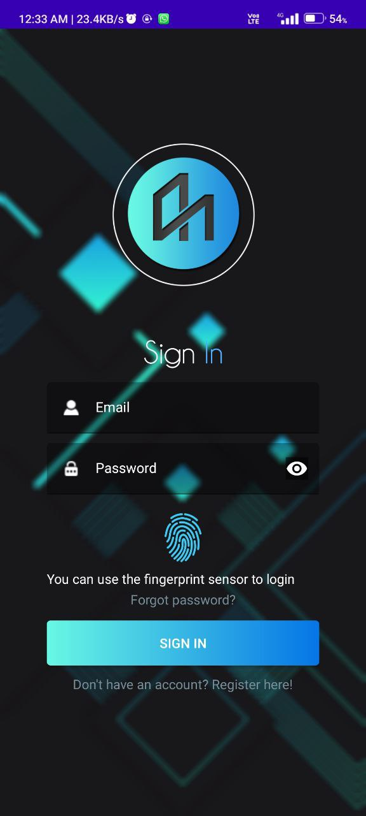
LOGIN SCREEN
In the Login Screen the User can Login with the Registered Email & Password.
The Email and Password having the Validation as Follows:-
Both can’t be Empty
Email Must be in Valid Format
Biometric Validations
Password Masking also Included.
Password Must have 1 Digit, 1 Lowercase
,1 Uppercase and Equal to 6 Characters
Also there is Biometric Logo ,
Forgot password Text link, Register Link and SIGN IN button.

Slide 13
ANIMATED INTRODUCTORY SCREEN
The Animated Introductory Screen will arrive when User go to the Registration page from that user can know the Features.
Three Introductory Screens are developed of Application Preview, Bill reminders and for Graph view.

Slide 14
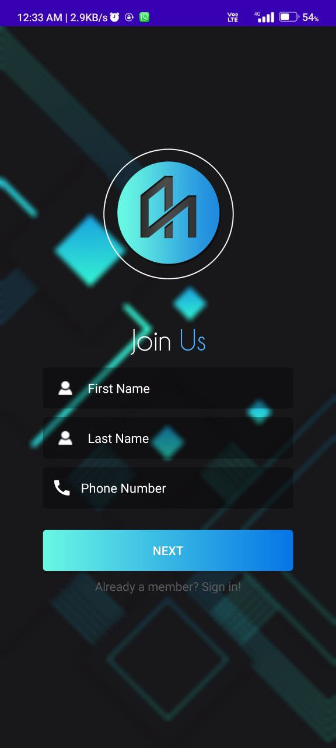
REGISTRATION SCREEN (1)
In the first registration screen the User can enter FIRST NAME , LAST NAME and PHONE NO.
The Fields having the Validation as Follows:-
All can’t be Empty
Phone no Must be in Valid Format in 10 Digits
Phone no only contains numbers as input
Also there is ALREADY MEMBER text link so user can go back to SIGN IN page.

Slide 15
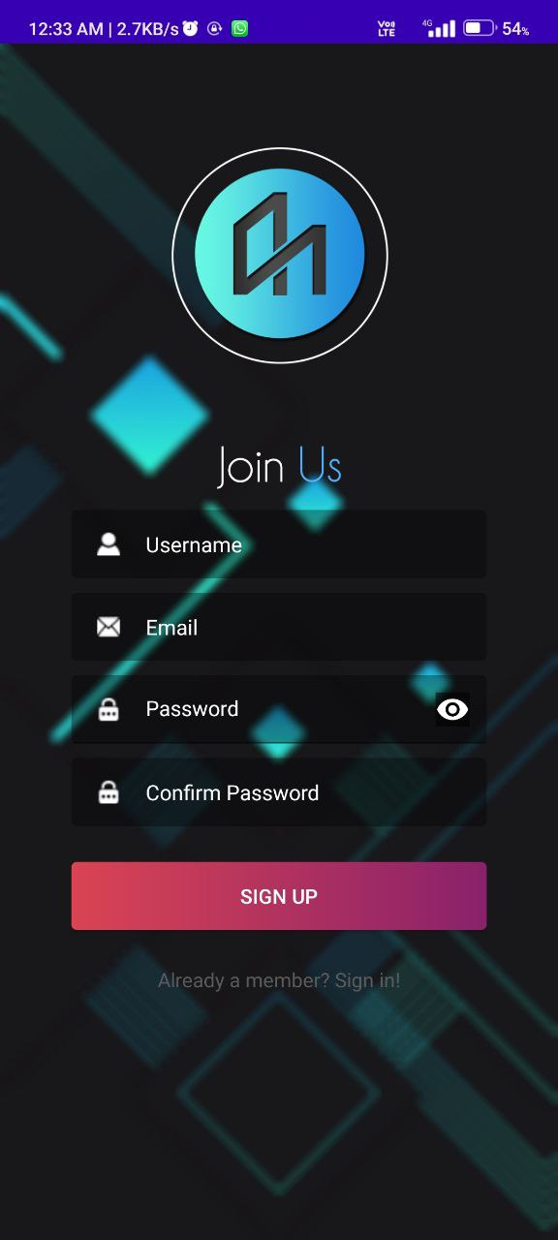
REGISTRATION SCREEN (2)
In the second registration screen the User can enter USERNAME, EMAIL and PASSWORD.
The Fields having the Validation as Follows:-
All can’t be Empty
Email Must be in Valid Format
Password with Masking included
Password must have 1 digit, 1 Uppercase letter and 1 Lowercase letter
Password must have Equal to 6 digits
Confirm password and password must be same
Also there is ALREADY MEMBER text link so user can go back to SIGN IN page.

Slide 16
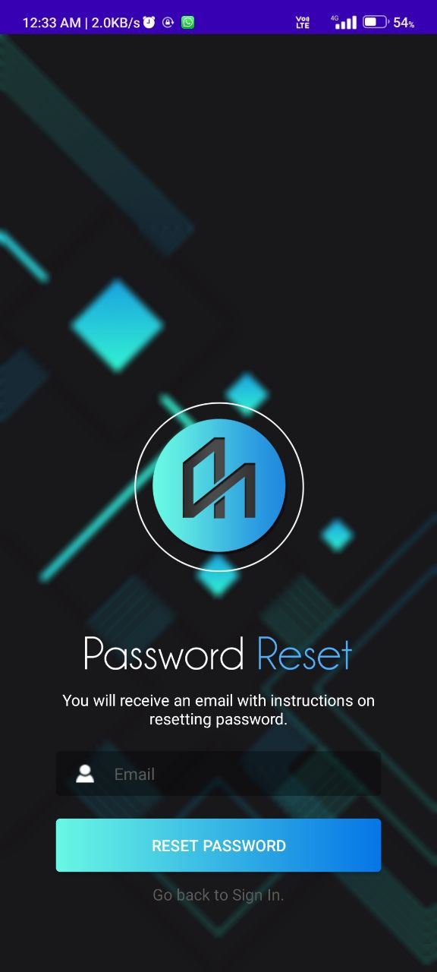
PASSWORD RESET SCREEN
In this screen the user can change the password anycase he/she forgots.
The Password can be changed with REGISTERED EMAIL only.
On registered email one Authentication Mail will arrive and from that the NEW PASSWORD can be put.
The Fields having the Validation as Follows:-
Field can’t be Empty
Email Must be in Valid Format
Email must be REGISTERED
Also there is GO BACK TO SIGN IN text link so user can go back to SIGN IN page.

Slide 17
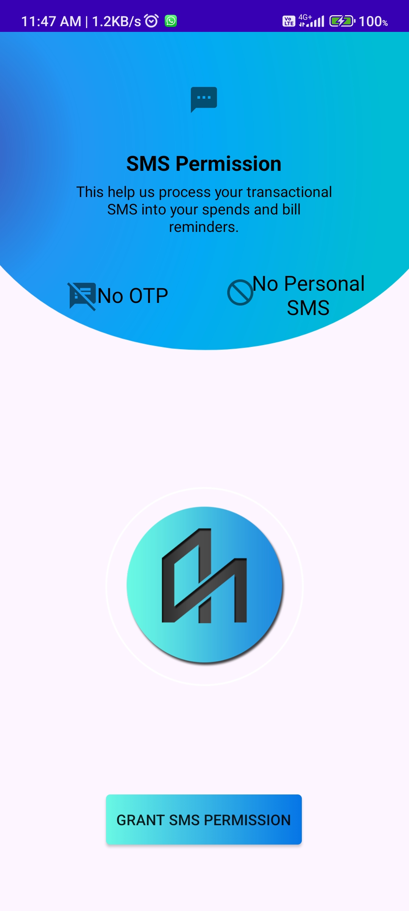
SMS PERMISSION
When the user installs the application for first time it will ask for SMS PERSMISSION.
Then the SMS is fetched by our application for creating the analysis and reports for user.
No OTP are taken by our application.
No Personal SMS is traced by our application
If user GRANT permission then only the SMS will be fetched otherwise not.

Slide 18
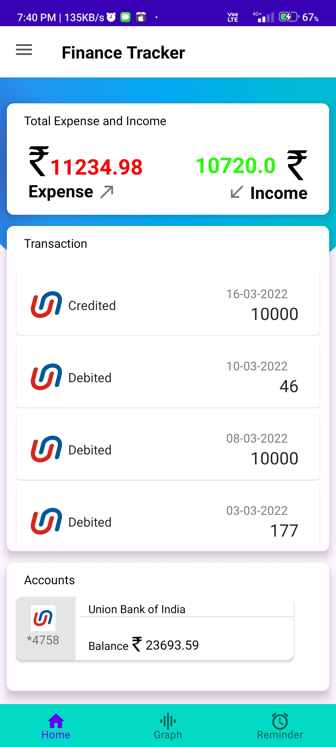
DASHBOARD SCREEN
The main dashboard screen having 3 sections divided.
The First section is for EXPENSE & INCOME where user can see the total expense and income.
The Second Section is for the TRANSACTIONS in that user can see bank logo , transaction type , date and amount.
The Third section having the Bank Accounts showing the bank logo , Bank accno, Bank name and Main Balance.

Slide 19
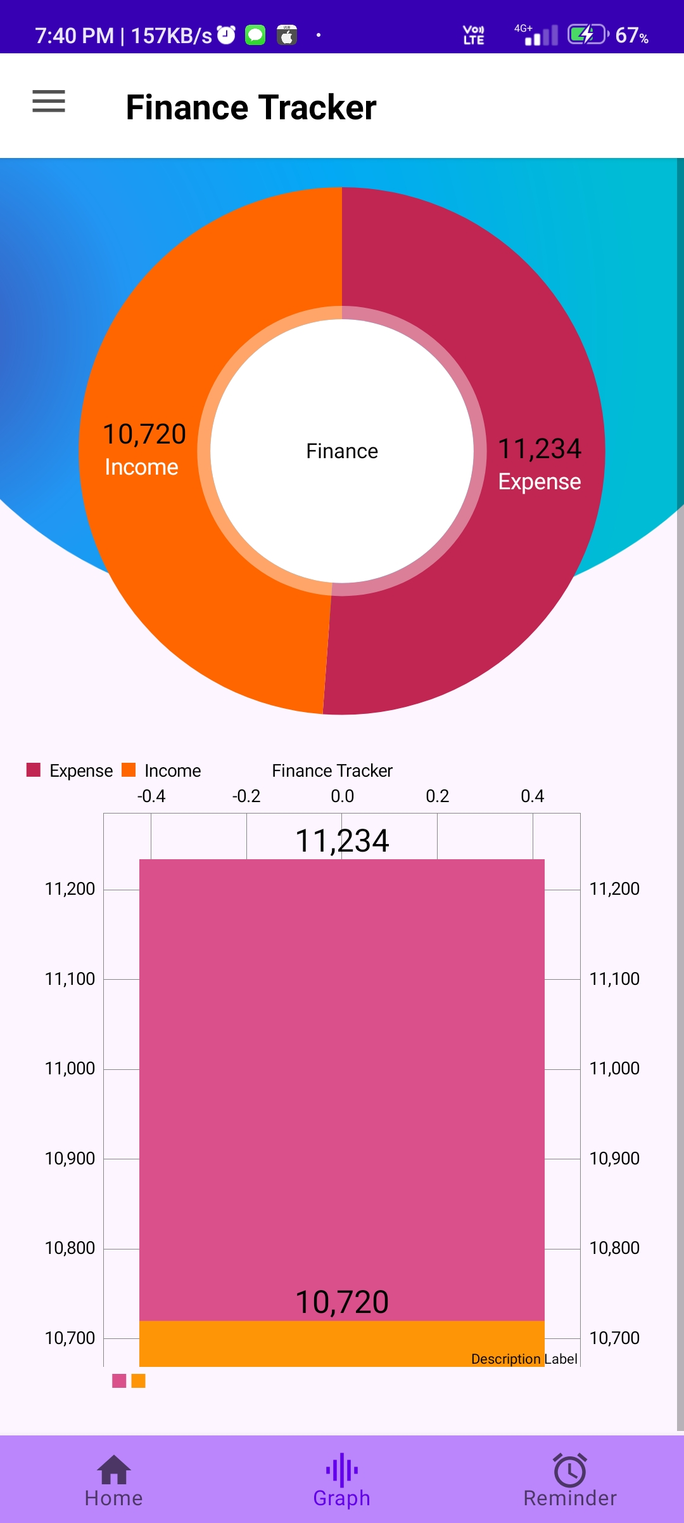
GRAPH SCREEN
The GRAPH screen will show the two different graphs PIE CHART and the BAR GRAPH.
The user can see the total expense and income with the visuals also it makes easy to analyze of the Income and Expense.

Slide 20
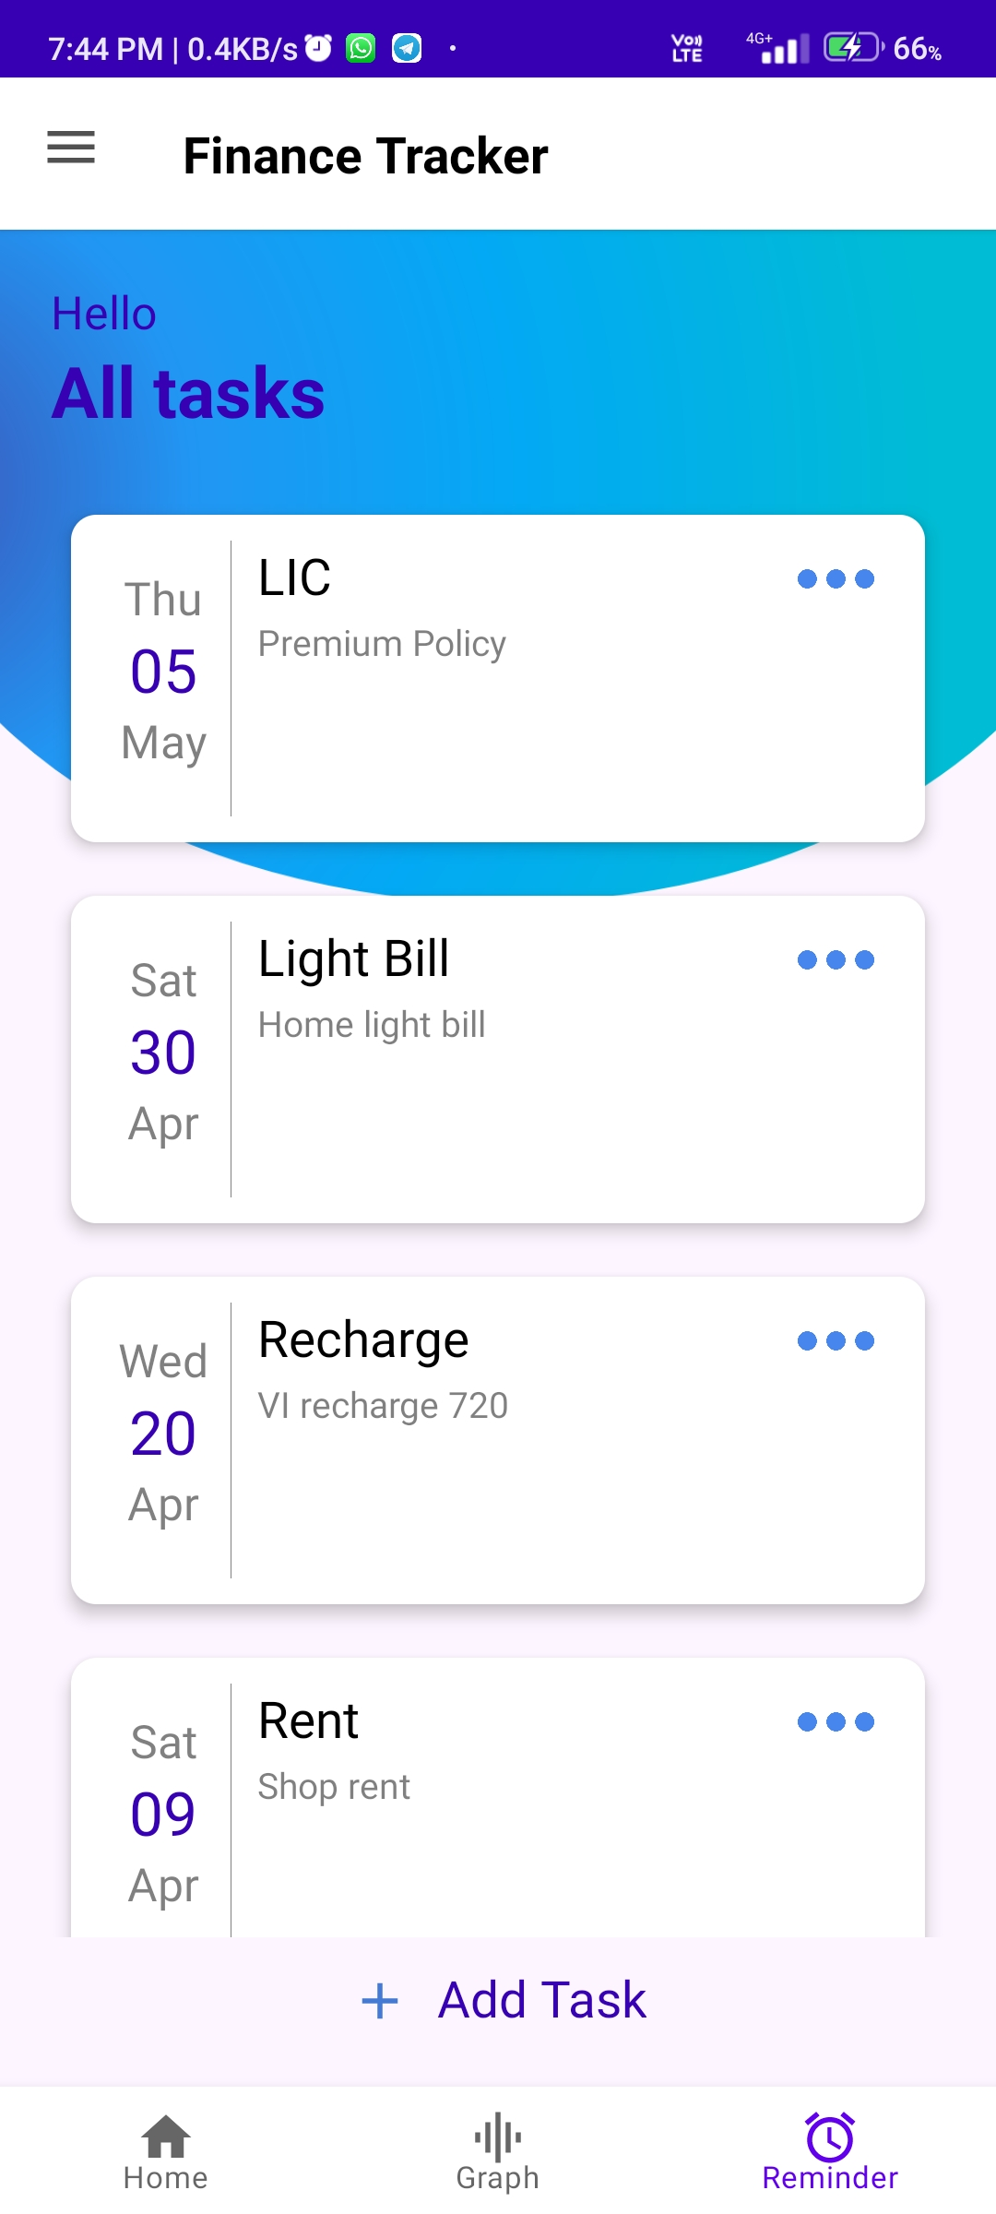
REMINDER SCREEN
The REMINDER screen will show the number of the reminders which user has put into the queue.
The user can see all the reminders with the Title , Date , Month, Day and Description.
Also the user can make a task complete and also can delete the reminder with the Menu option given at top right of every reminder.

Slide 21
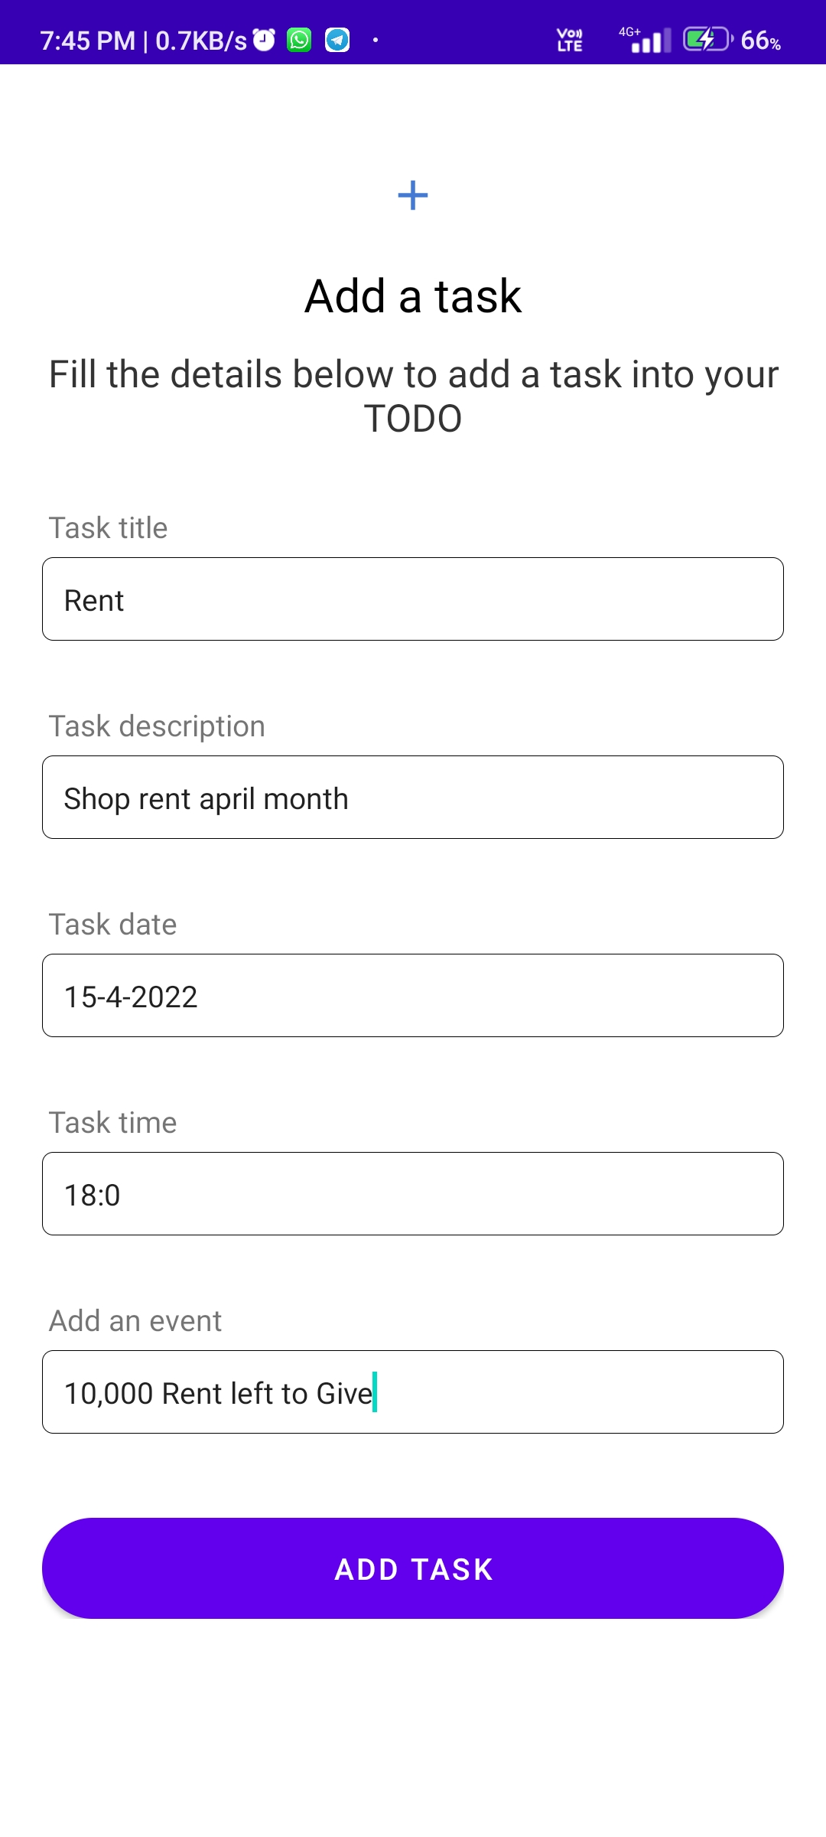
ADD TASK SCREEN
The ADD TASK SCREEN allows the user to add their tasks.
The user can enter all the details of reminders like Title , Date , TIME and Description.
When user click on the ADD TASK BUTTON the task will added on the REMINDER SCREEN in queue.

Slide 22
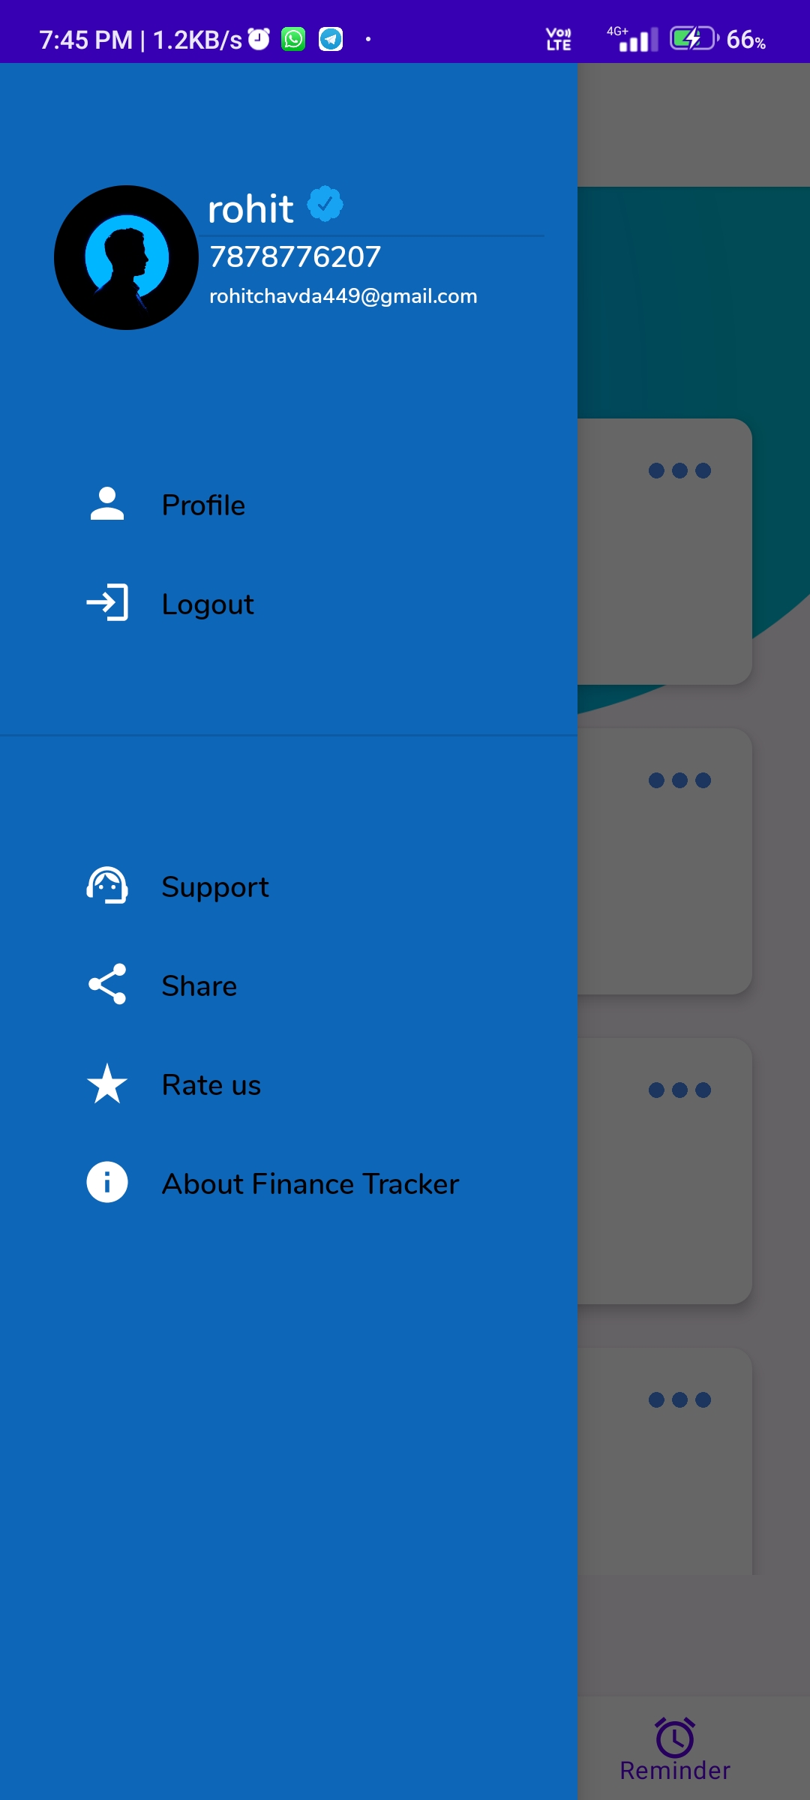
NAVIGATION DRAWER
The NAVIGATION DRAWER allows the user to perform variety of the tasks.
The user can see the username with mobile and email on drawer.
The user can update the profile by clicking on the PROFILE ITEM.
The LOGOUT ITEM is thier for doing the LOGOUT.
There is one SUPPORT button to contact with the CUSTOMER CARE.
SHARE item can share the application on any social medias or any other communications.
The RATE US item is for giving the STARS raating for application.
The ABOUT item is having the website link where user can READ about our application.

Slide 23
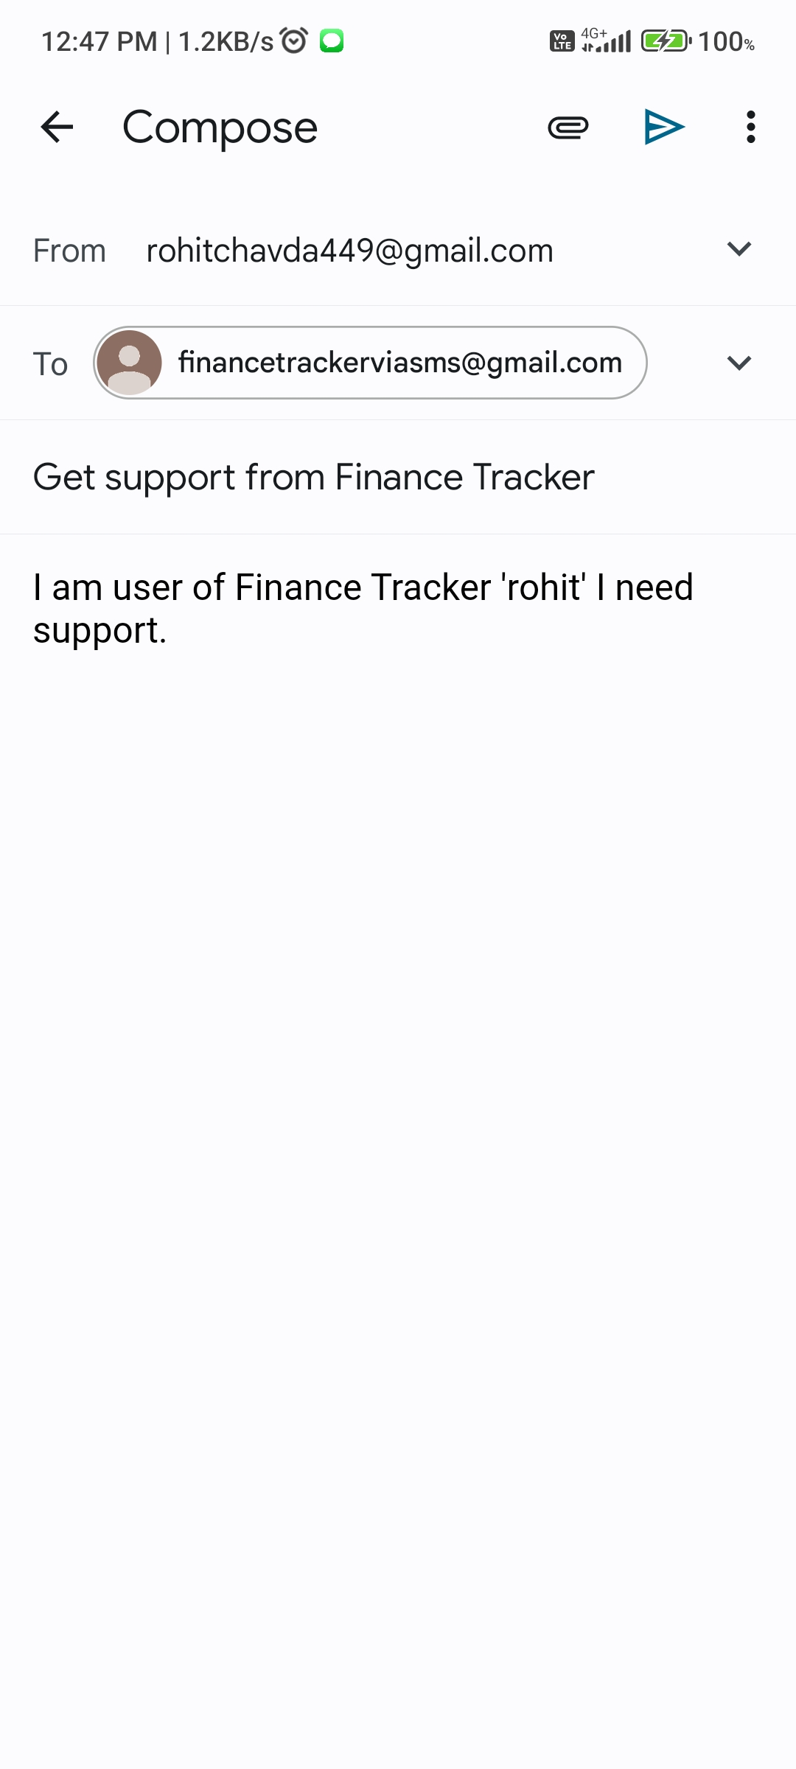
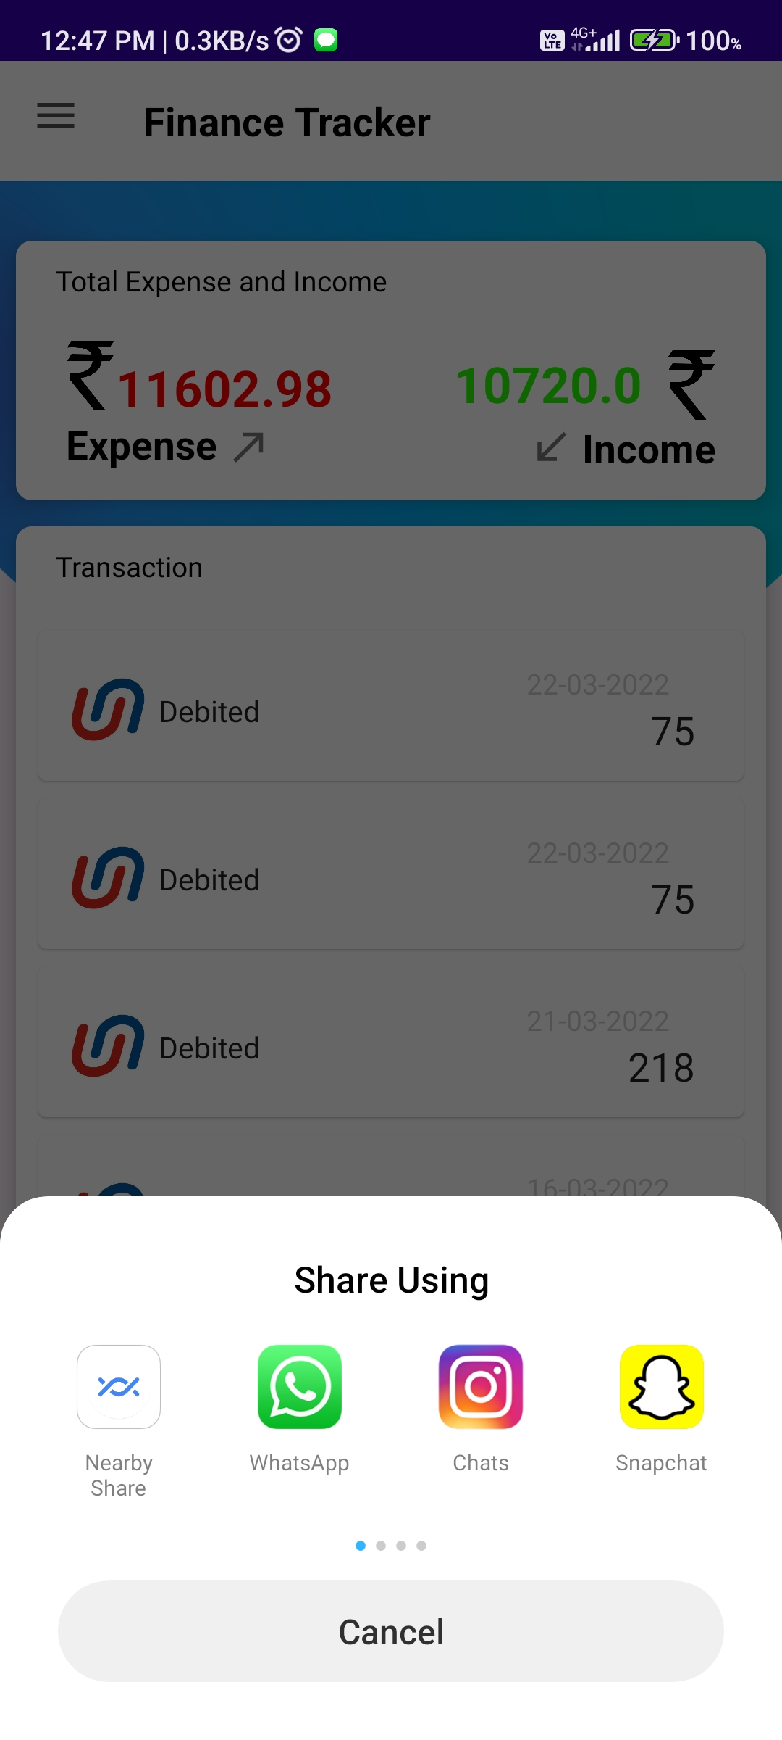
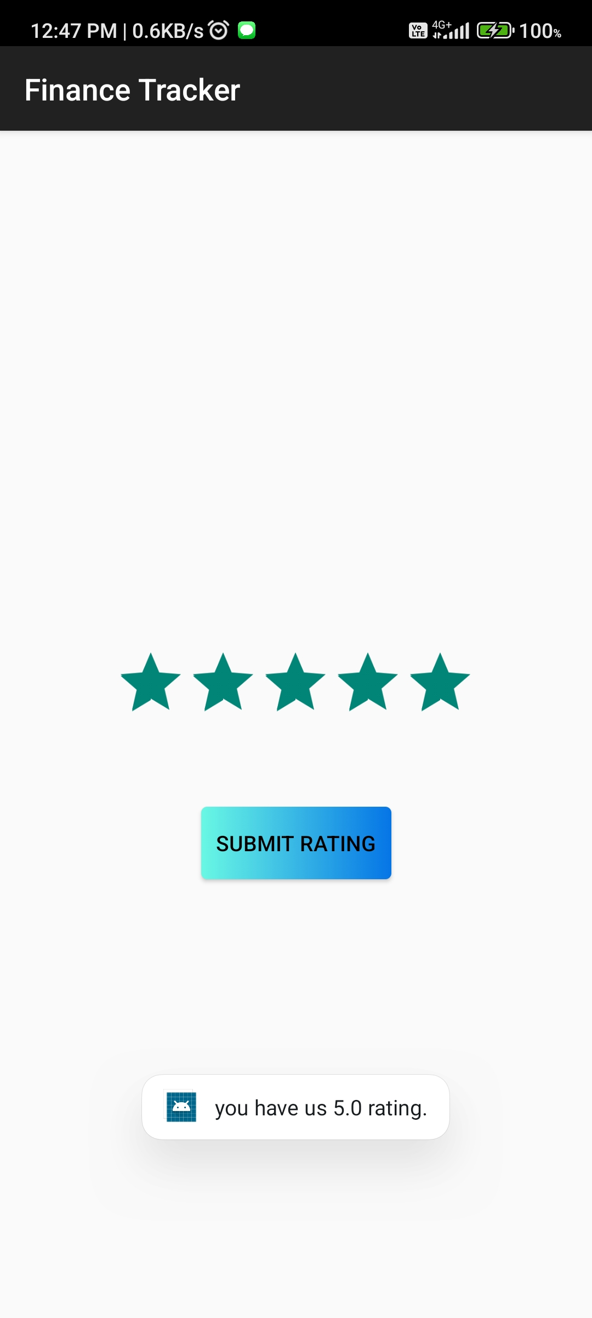
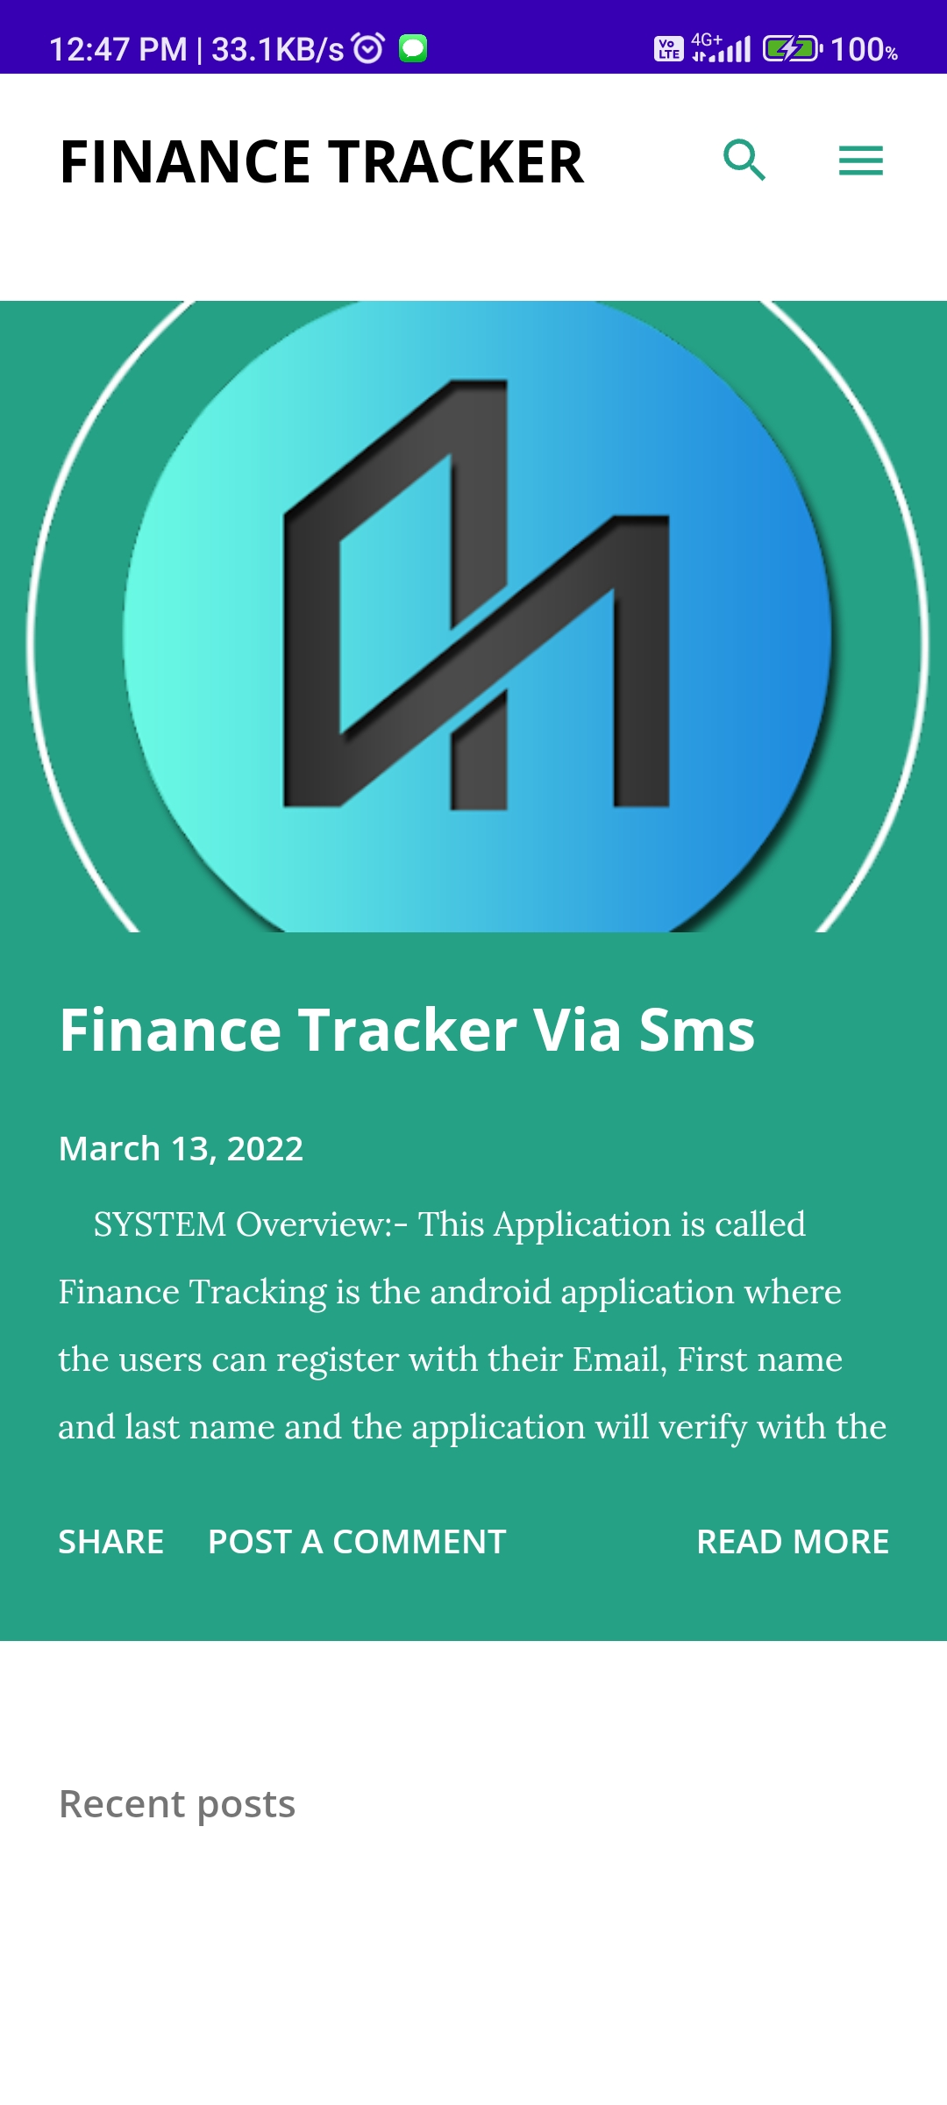
NAVIGATION DRAWER (SUB PARTS) 1) SUPPORT 2) SHARE 3) RATEUS 4) ABOUT

Slide 24
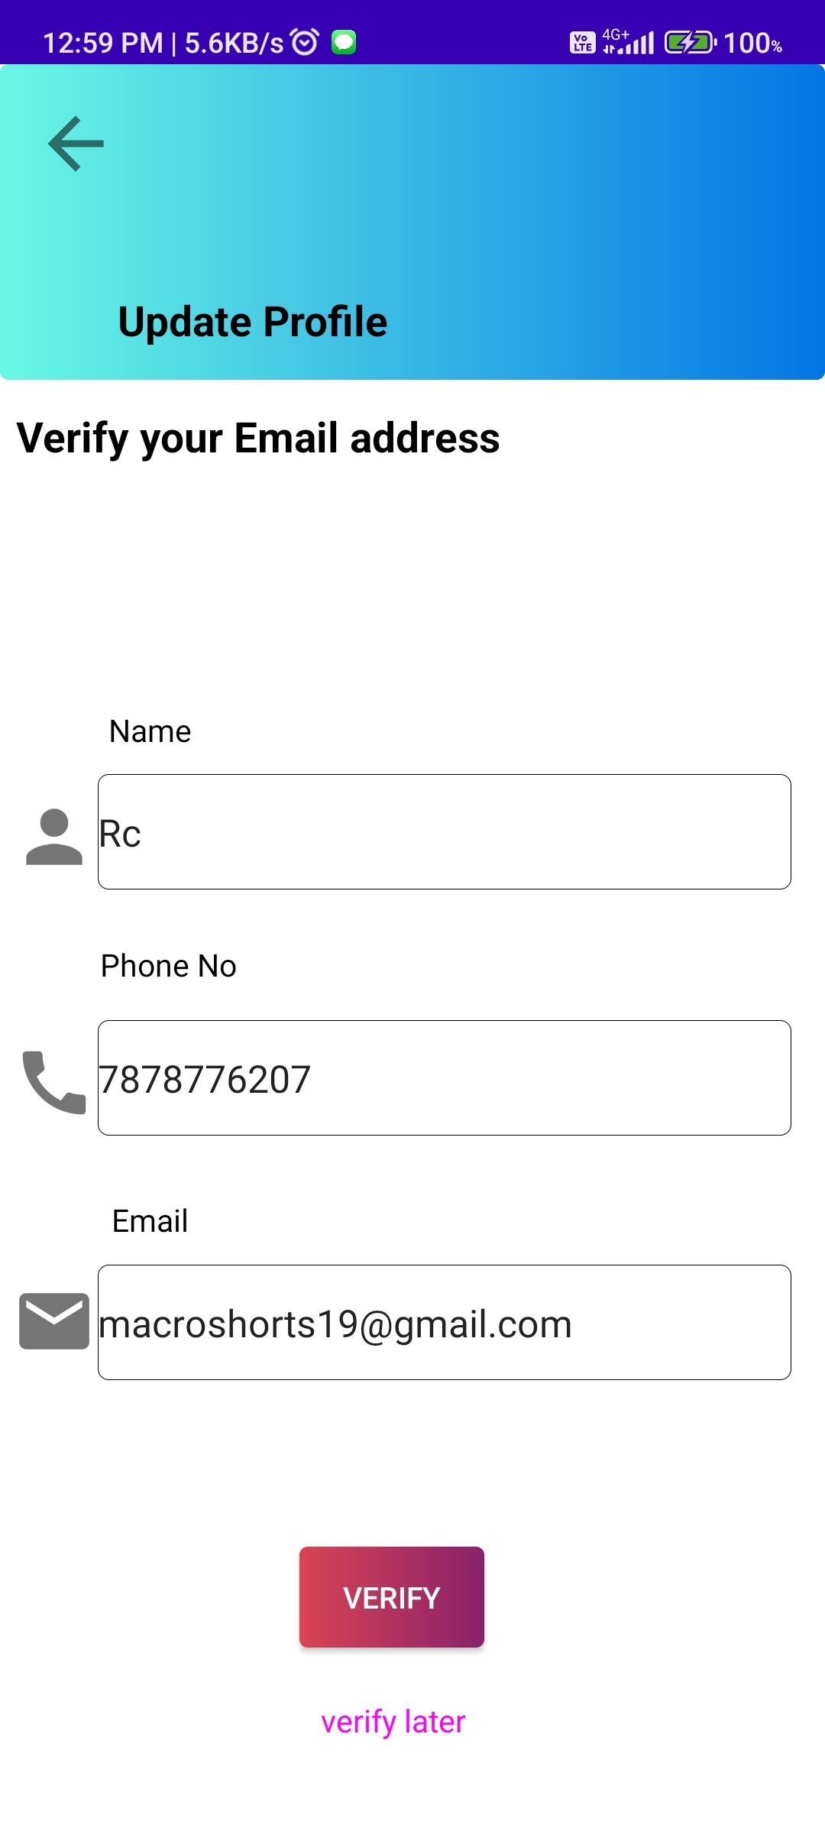
UPDATE PROFILE SCREEN
The UPDATE PROFILE section will open from the navigation drawer.
The user can update the USERNAME , PHONE NO and the EMAIL ID.
On REALTIME it will updated in the FIREBASE DATABASE and on next login the new EMAIL is required.
With VERIFY the process will go ahead and with VERIFY LATER it will move back to DASHBOARD.

Slide 25
04
Obstacles
Limitation of this project.

Slide 26
LIMITATIONS OF APPLICATION
The Finance Tracker application has an Main limitation which is the SMS NOT ARRIVE like when the user done a transaction but from the bank message not arrived.
The another limitation is the SMS arrive with DIFFER FORMAT so application couldn't TRACE OUT.
The application is not having much Filters to deep analysis of the TRANSACTIONS.

Slide 27

05
Existing vs. New Application
The Key difference between the Old and new system.

Slide 28
Existing Vs. New Application
In the old all work was done handmade on the papers which was very tedious and time consuming but now it is digitalized with the application.
In the old application the work is done manually all the transactions of the bank are inserted manually but here it is automatically done with the help of SMS.
In the old application the transaction was entered manually and then the REPORTS was generated but here the reports also generated AUTOMATICALLY.

Slide 29
DFD (DATA FLOW DIAGRAM)
06
Finance Tracking
Logical DFD
Physical DFD

Slide 30
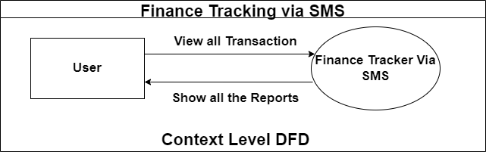
Context Level DFD

Slide 31
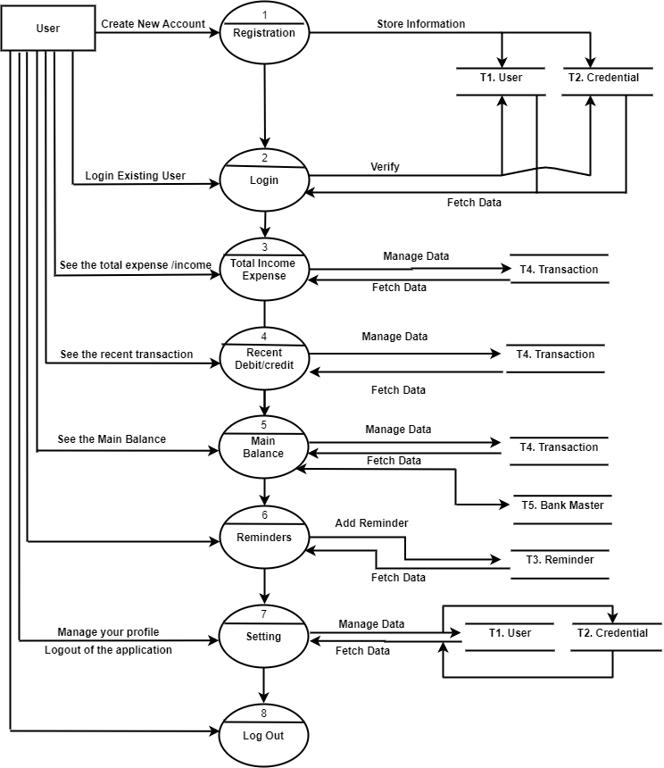
First Level DFD

Slide 32
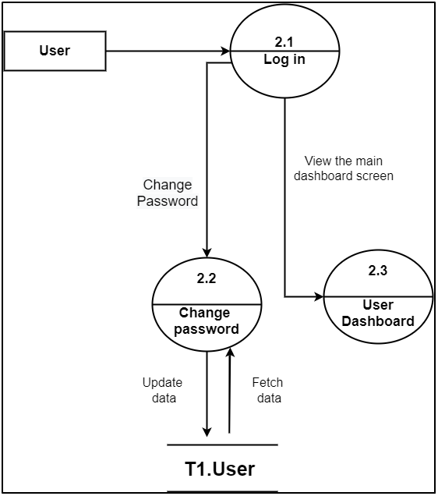
Second Level DFD
Second level For User Login

Slide 33
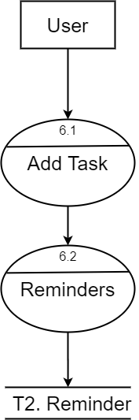
Second Level DFD
Second level For adding the Reminders

Slide 34
07
ER
DIAGRAM
Shows the Relationship between the tables.

Slide 35
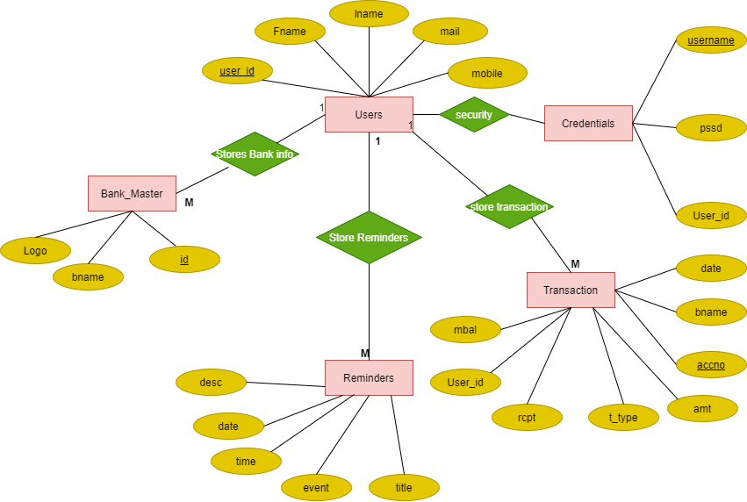
ER DIAGRAM

Slide 36
08
AUTHENTICATION
Authentication of users with FIREBASE DATABASE

Slide 37
Authentications
We provide Authentication on registration like EMAIL VERIFICATION with FIREBASE.
User can only login when the EMAIL is VERIFIED by the FIREBASE AUTHENTICATION.
On RESET password the mail link will be sent to REGISTERED email for AUTHENTICATION of the VALID user for resetting password.
If the Valid user has not done this then it can be UNDO from MAIL received in Mail BOX.
On first login the BIOMETRICS will be disabled for security and if one time user had logged in then BIOMETRICS will DISPLAY.
REALTIME VERIFICATION of MAIL.

Slide 38
09
FUTURE SCOPE
Why this Application will be used in Future??

Slide 39
Future Scope
In the future scope it will be used because if someone have more than one bank account it will be easy to identifies.
When there is more account we have to put the All Bank apps for the Mini Statements and the Balance but all the things in one application.
We don’t have to put the extra reminder app for our bills and tasks it is also provided here.
In future we also enhance the filters that the user can only see the particular account details and can also hide the accounts.
We will be adding the CASH MODULE and it will used when the user had done the transaction in the CASH.

Slide 40
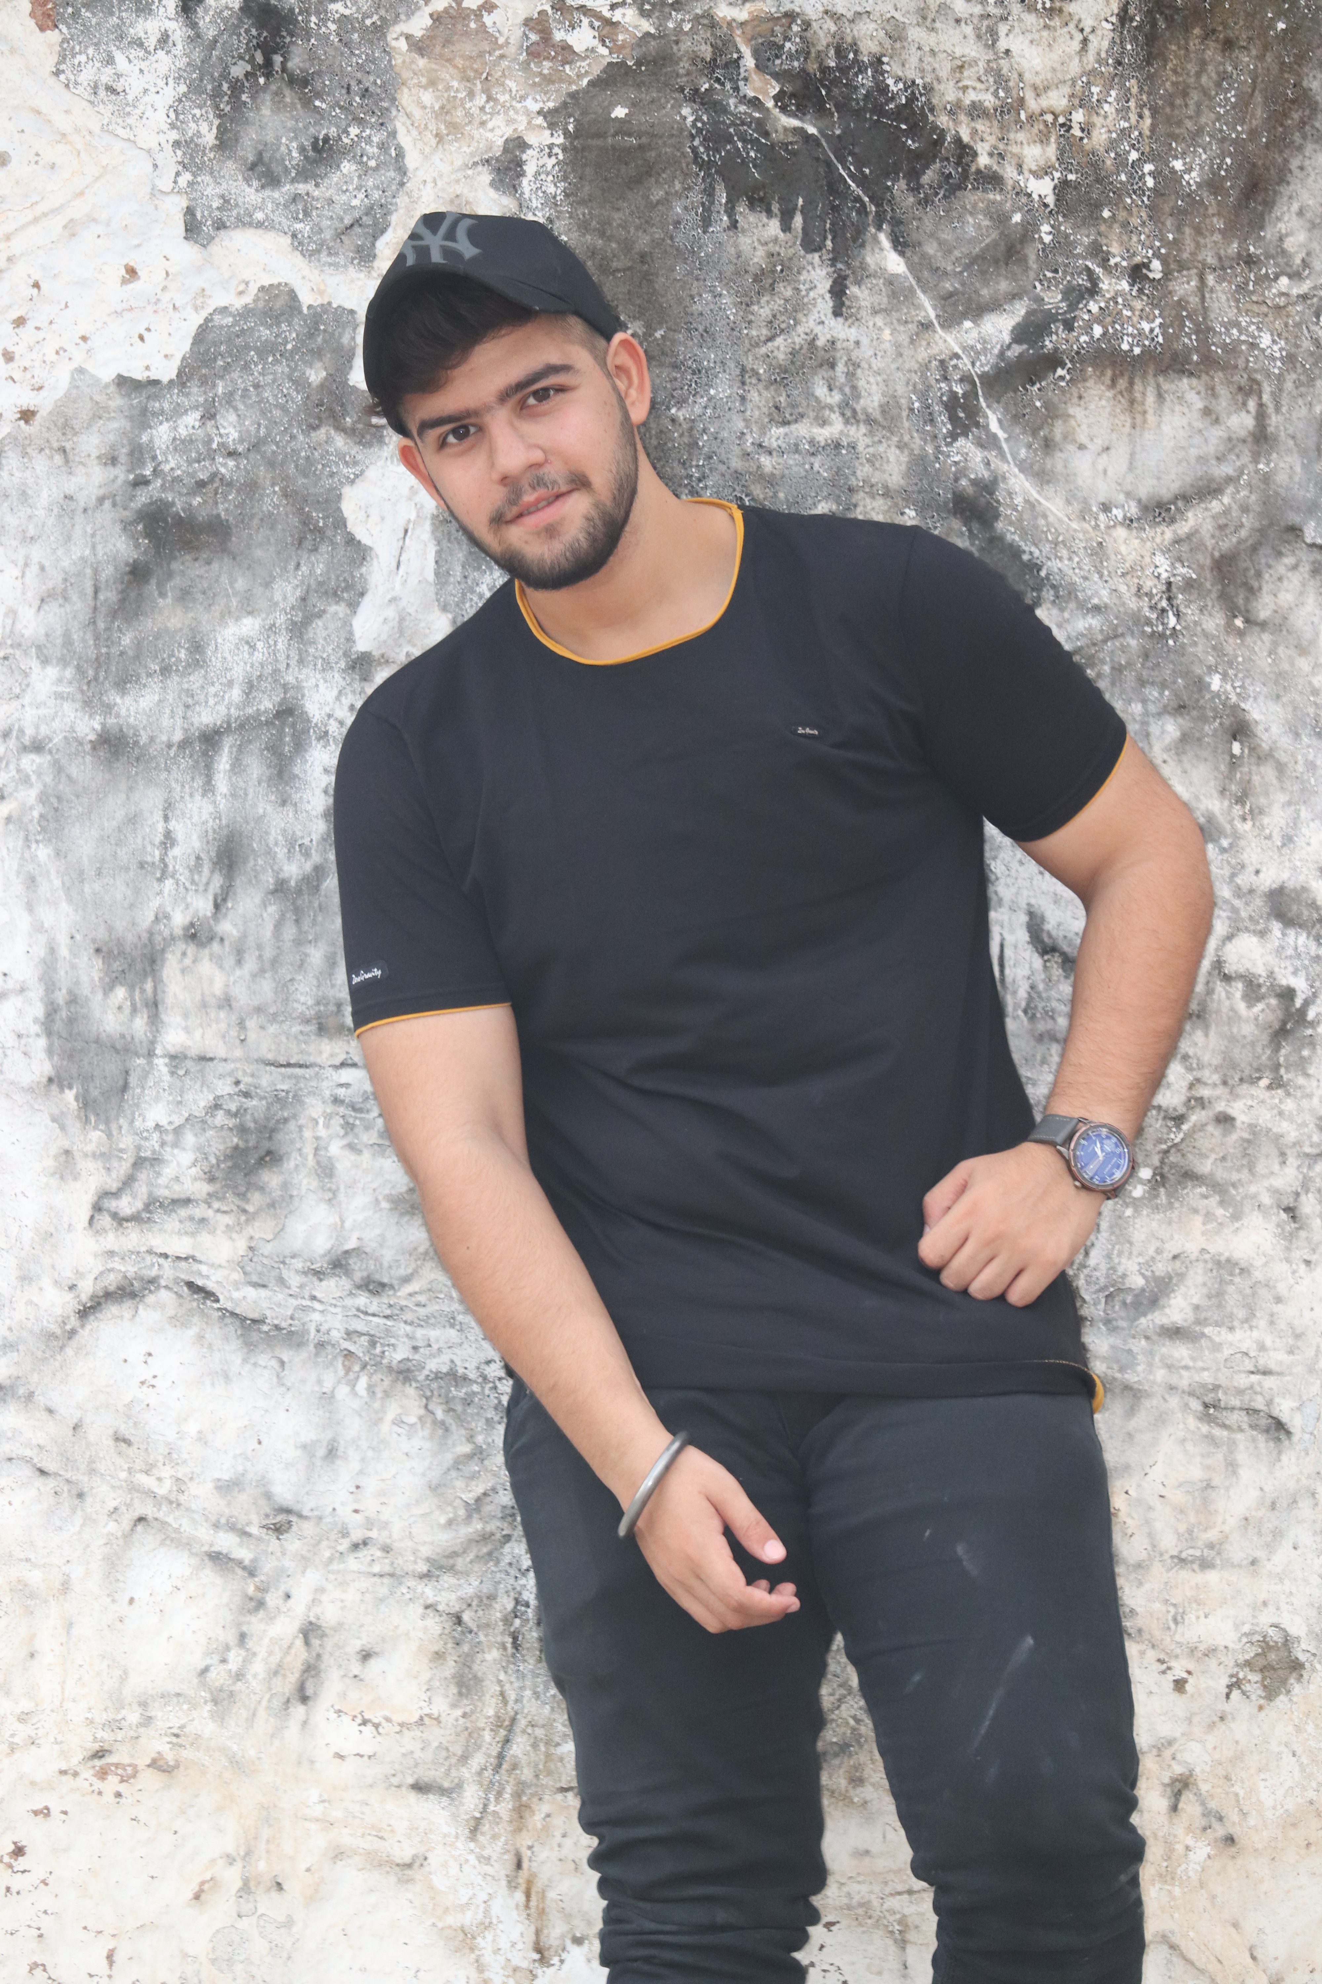
THANK YOU RESPECTED DIGNITY
CHAVDA ROHIT M
SEM 6 BCA
SEAT NO:- 21260153

